Slide 1

Final Presentation of Project DBS Bank LOAN Data analysis
Presented by (Group 2): RUSHIKESH, Nayan Kumar, SHIVANJALI,SABA,PURVA, SHRAVANI, VRUSHALI

Slide 2
Index
Project introduction
Objective and scope
Key KPI’s
KPI’s key performance indicators
Insights
Recommendations
Exclusive summaries
Excel Dashboard
Tableau Dashboard
Power Bi Dashboard
Overall insights
Learning from the Project

Slide 3
Project Introduction
This project focuses on analyzing banking data to identify patterns, trends, and insights that can help in improving decision-making.
Banks generate massive amounts of data every day through Loan accounts, Loan deposits, Loan withdrawals, loans, credit cards, and transactions across different branches.
However, this raw data is complex and not directly useful without proper cleaning and analysis.
Our project aimed to transform this raw data into meaningful dashboards that highlight branch performance, loan distributions, customer segmentation, and overall financial trends.

Slide 4
Objectives & Scope
The main objective of this project was to utilize data analysis techniques to understand customer behavior, analyze branch performance, and track key banking metrics.
Excel provided quick analysis and pivot summaries, Tableau helped in creating interactive dashboards, and Power BI enabled KPI-focused reports.
This project also aimed to compare the strengths of each BI tool and demonstrate how teamwork and different tools can work together to generate actionable insights.

Slide 5
Key KPIs
Total Clients: 2K
Active Clients: 324
Total Funded Amount: ₹5,23,61,094
Top 3 Loan Distribution by Branch: Dhuri Branch, Motihari Branch, Bilaspur Branch
Total Repayments Collect : 5,38,61,255

Slide 6
Key Performance Indicators (KPIs)
New Clients: 870
Sum of Total Amount: 52M
Average Loan Amount: 26.18K
Total Repayment Collect: 54M

Slide 7
Insights
Total Transactions: 100,000 | Unique Customers: 100,000 | Banks: 6 | Branches: 6
Total funded amount: ₹5,23,61,094| Total loan Disbursed: ₹5,23,61,121| On time repayments%: 71.05%
Average Loan Amount: ₹26.18K|
Best Branches (Net Loan Flow): East Branch, Suburban Branch, North Branch
Top Loan Distributed by branch: Sangrur Branch, Dhuri branch, Bulandshah Branch.,
Credit outpaces Debit in most months; monitor months with debit spikes.
Transaction methods show concentration—optimize offers/UX for top-used methods.
Banks with the highest totals can be prioritized for cross-sell and partnerships.

Slide 8

Recommendations
Double down on high net cash-flow branches; replicate their practices across branches.
Target top customers with loyalty offers and personalized products.
Review months/quarters with debit spikes; investigate drivers and mitigate risk.
Streamline top transaction methods to reduce friction and increase throughput.
Align bank partnerships and campaigns with banks driving the highest volumes.

Slide 9
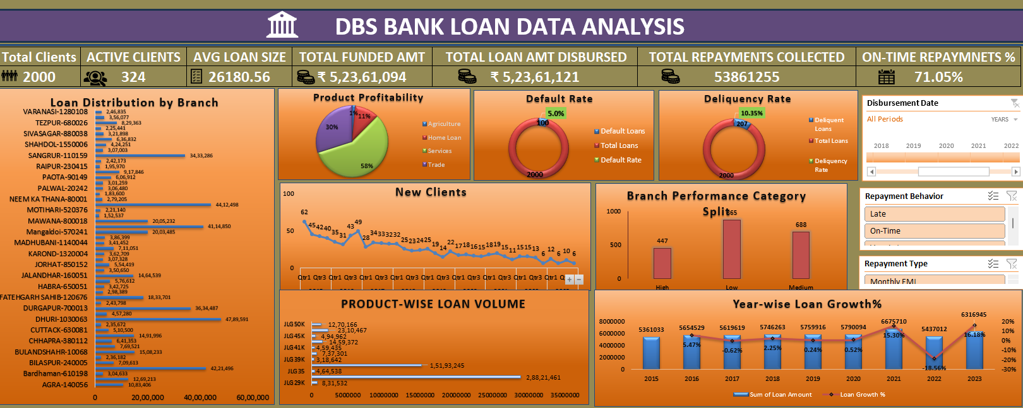
Excel Dashboard : DBS Bank LOAN Analysis Dashboard

Slide 10
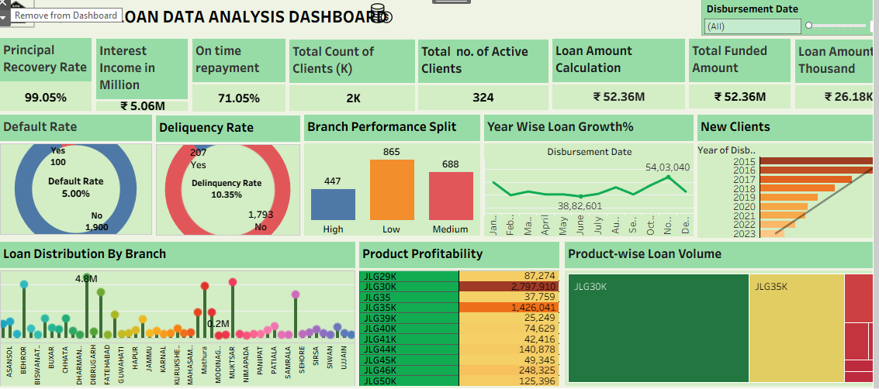
Tableau Dashboard: bank LOAN data analysis

Slide 11
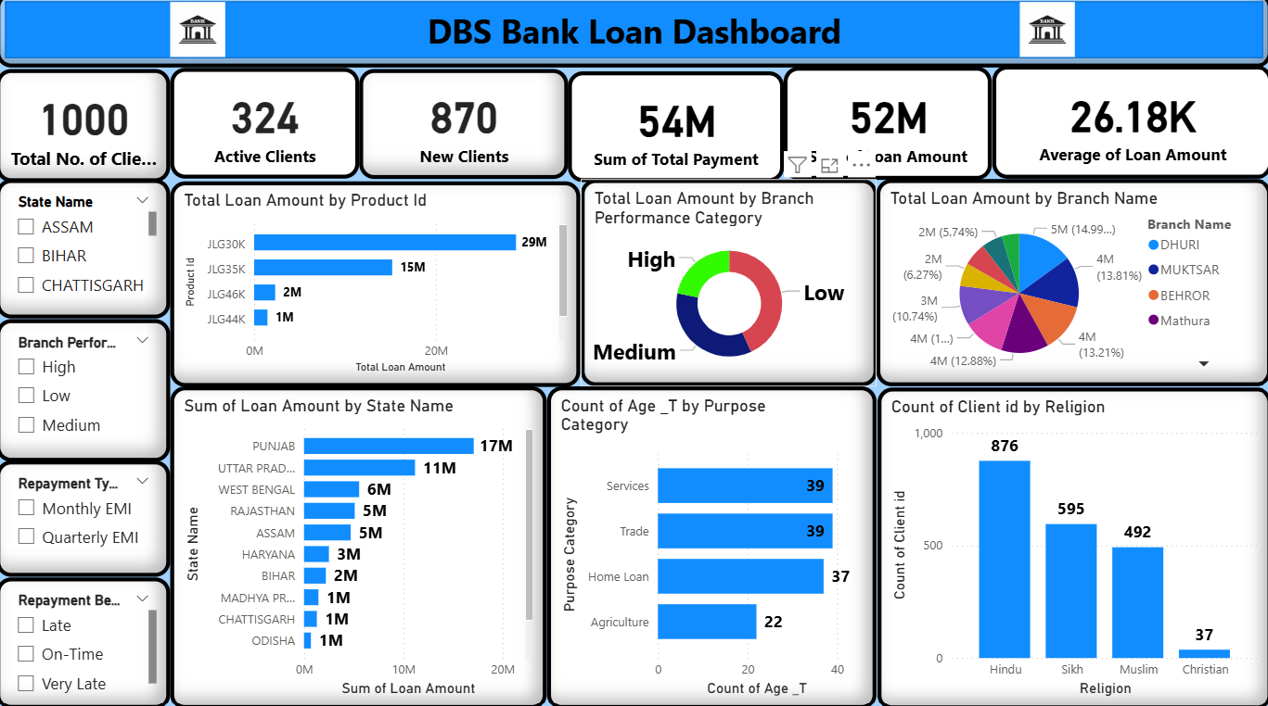
Power BI: DBS Bank LOAN Data analysis

Slide 12
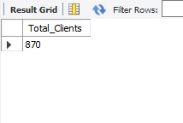
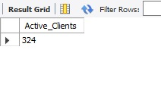
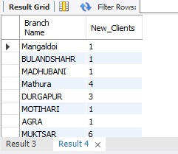
SQL: DBS Bank LOAN Data analysis
01.Total Clients
SELECT COUNT(DISTINCT `Client id`)
AS Total_ClientsFROM banking_dataset;
Active Clients
SELECT COUNT(DISTINCT `Client id`)
AS Active_ClientsFROM banking_dataset
WHERE `Loan Status` = 'Active';
02.New Clients
SELECT `Client id`, MIN(`Disbursement Date`)
AS First_Loan_DateFROM banking_dataset
GROUP BY `Client id`;
SELECT b.`Branch Name`, COUNT(*)
AS New_ClientsFROM ( SELECT `Client id`, `Branch Name`,
MIN(`Disbursement Date`) AS First_Loan_Date
FROM banking_dataset GROUP BY `Client id`, `Branch Name`)
AS bWHERE First_Loan_Date BETWEEN '2023-01-01' AND '2023-03-31‘
GROUP BY b.`Branch Name`;

Slide 13
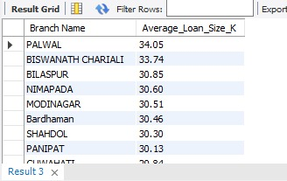
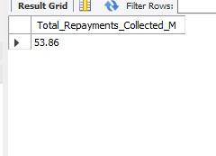
Average Loan Size
SELECT `Branch Name`, ROUND(AVG(`Loan Amount`) / 1000, 2)
AS Average_Loan_Size_KFROM banking_dataset GROUP BY `Branch Name`
ORDER BY Average_Loan_Size_K DESC;
Total Repayments Collected
SELECT ROUND(SUM(`Total Payment`) / 1000000, 2)
AS Total_Repayments_Collected_MFROM Fact_Repayment;

Slide 14
Overall Insights
From our analysis of the banking data, we found several key trends. Some branches performed better than others in terms of deposits and loans. Customer behavior varied, with certain customers contributing more to deposits, while loans were distributed across many branches. We also observed seasonal patterns in transactions, showing months with higher activity. These insights help the bank understand overall performance, identify areas for improvement, and make better decisions.
SQL = backbone for clean data
Excel = quick analysis tool
Tableau = storytelling & visual exploration
Power BI = KPI-driven dashboard & reporting
Teamwork in combining tools gave holistic insights

Slide 15
Learnings from the Project
Through this project, we learned how to work effectively as a team by dividing tasks, collaborating on ideas, and combining our efforts into a single outcome.
Each member contributed to different parts of the project such as data cleaning, dashboard creation, and presenting insights.
We also gained hands-on experience with multiple BI tools — SQL, Excel, Tableau, and Power BI — and understood their unique strengths and limitations.
Most importantly, we learned how teamwork and the right use of tools can transform raw data into meaningful insights that support real-world decision-making.

Slide 16
Thank you !!! 😊

